Slide 1
SWENG 837 Project
AI travel planner agent web application
By Tanuj Rane

Slide 2
Problem Statement
Problem: Trip planning is challenging, time-consuming, and involves juggling: Destination, Transportation, Weather, Activities, and Budget. Resulting in travelers losing confidence in plans and choosing to stay home
Goal: Reduce the challenges and time spent planning a trip

Slide 3
Target User
Target User: Travelers or individuals planning a vacation/trip who need assistance.

Slide 4
Design solution overview
Solution: AI travel planning agent will collect data (preferences, weather, flights, POIs, costs) and generates weather- and preference-aware trip plans.
Tech Stack
Frontend: React/Next.js.
Backend: Python/FastAPI (with Lang Graph).
Key External Services
MongoDB Atlas
OpenWeather API
Aviationstack API
Google Maps API
Exchange rate API

Slide 5
Core System Functionalities
Authentication (Google Oauth)
User Preferences (climate, pace, activities,budget)
AI-assisted Trip Planning (analyze feasibility, summarize points).
View weather for the trip
Transportation/flight (driving and flight option)
AI Itinerary Generation (day-by-day with explanations).
Trip Management (save, view, delete).

Slide 6
Design walkthrough

Slide 7
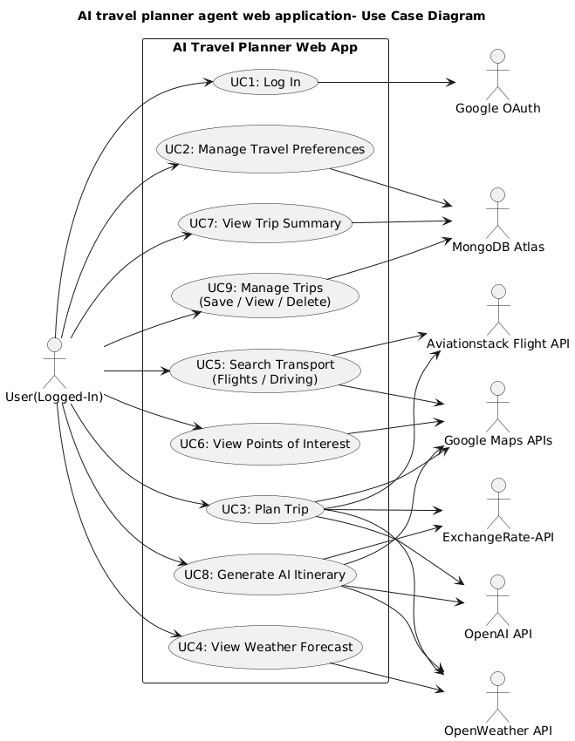
Use Case Diagram

Slide 8
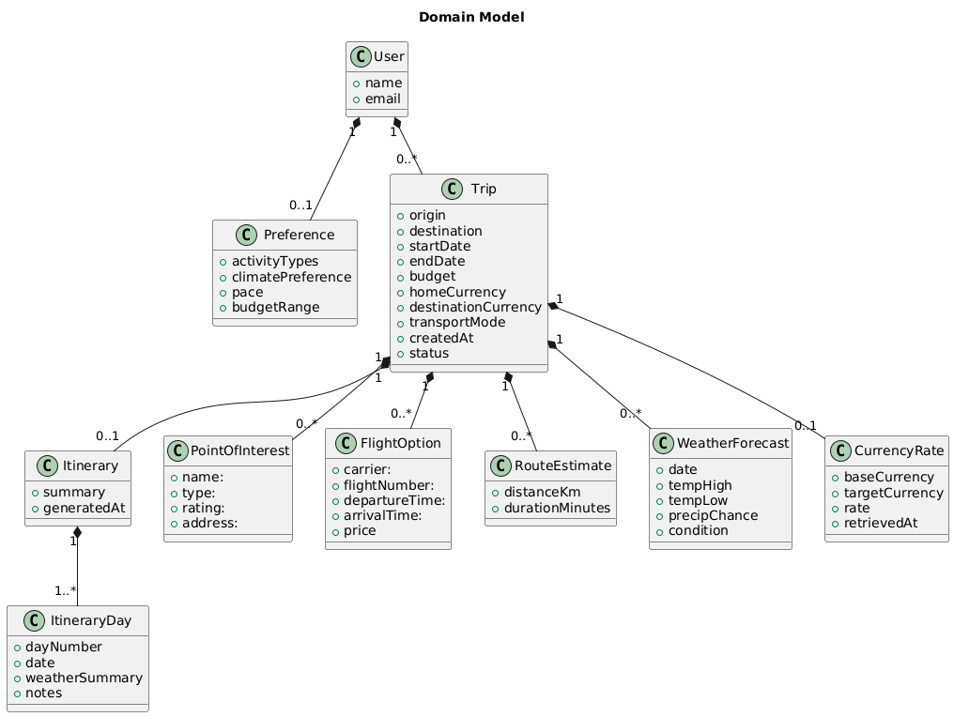
Domain Model

Slide 9
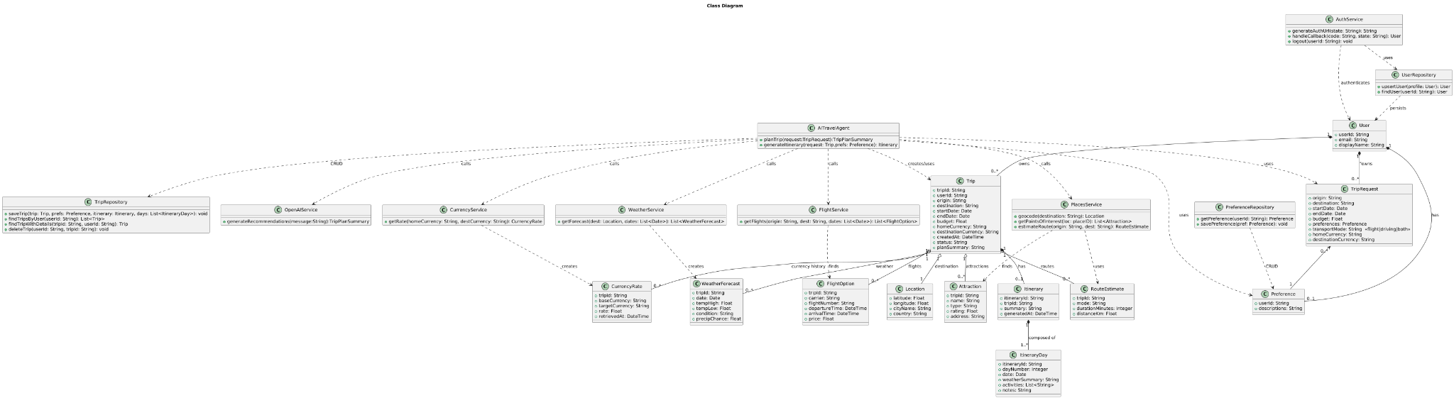
Class Diagram

Slide 10
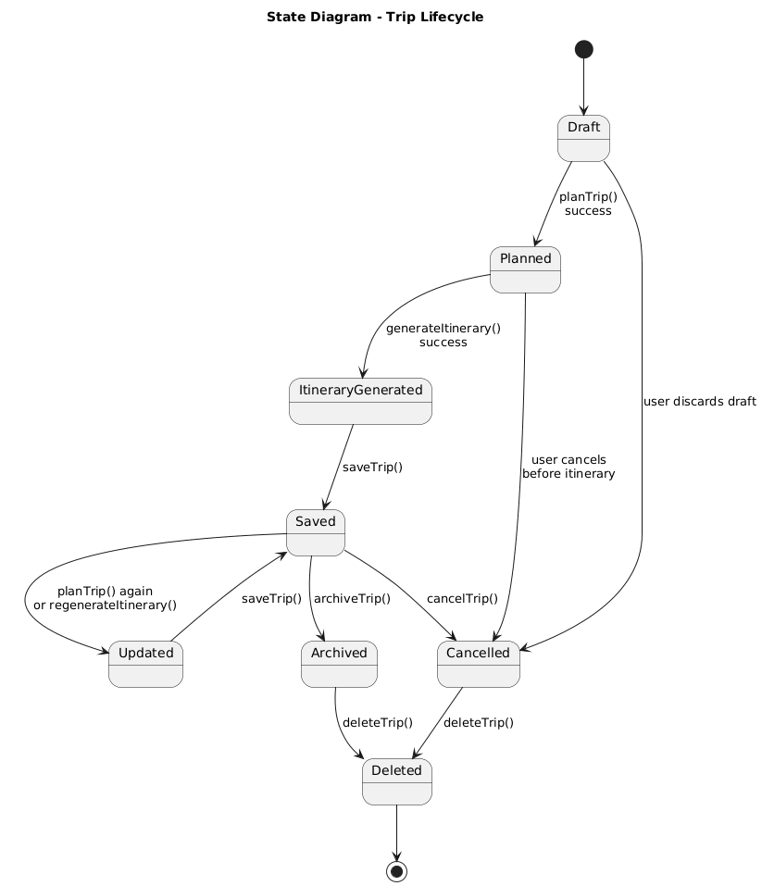
State Diagram

Slide 11
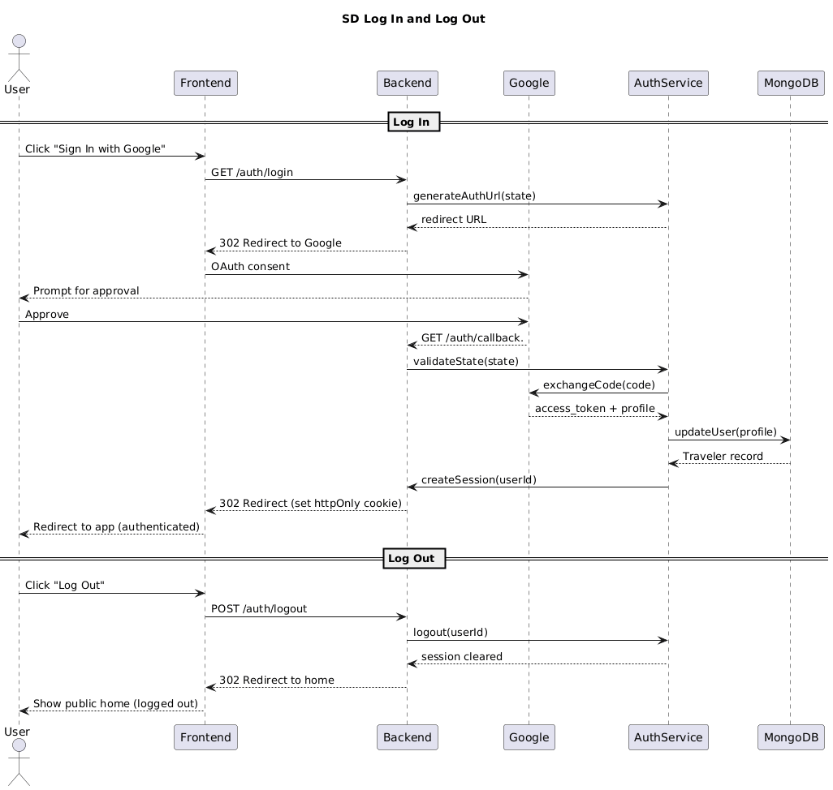
SD1 Login and logout

Slide 12
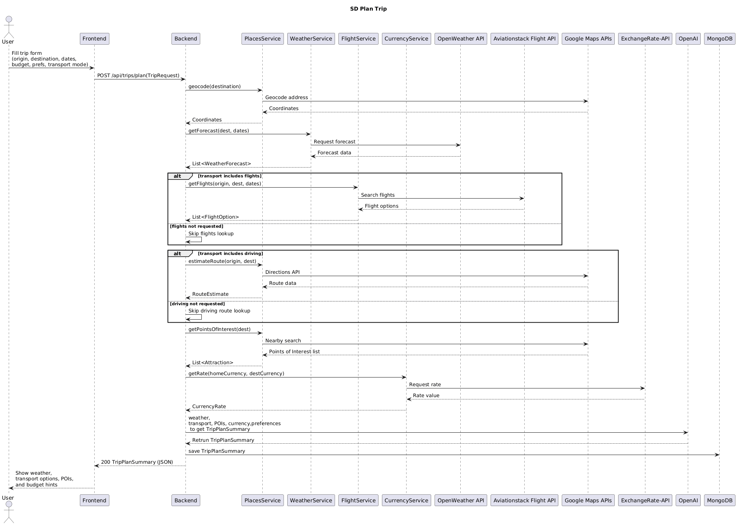
SD2 Plan Trip

Slide 13
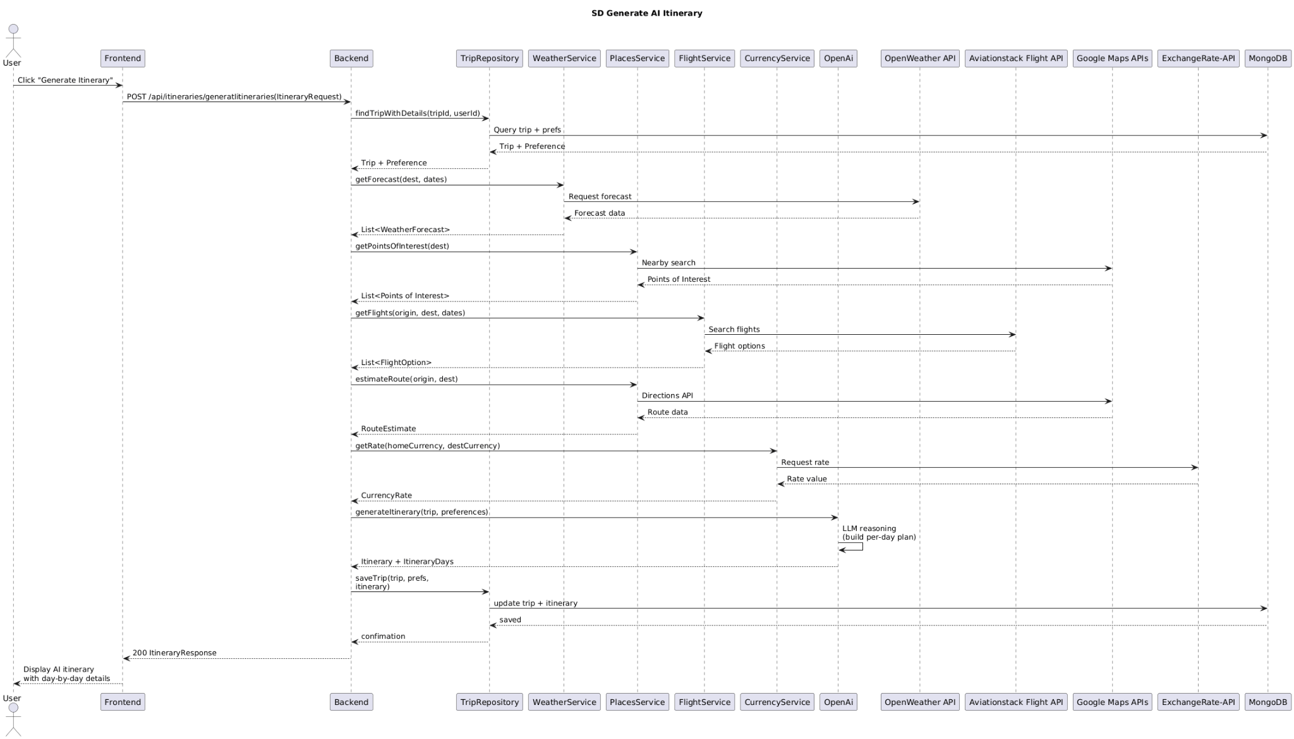
SD3 generate Itinerary

Slide 14
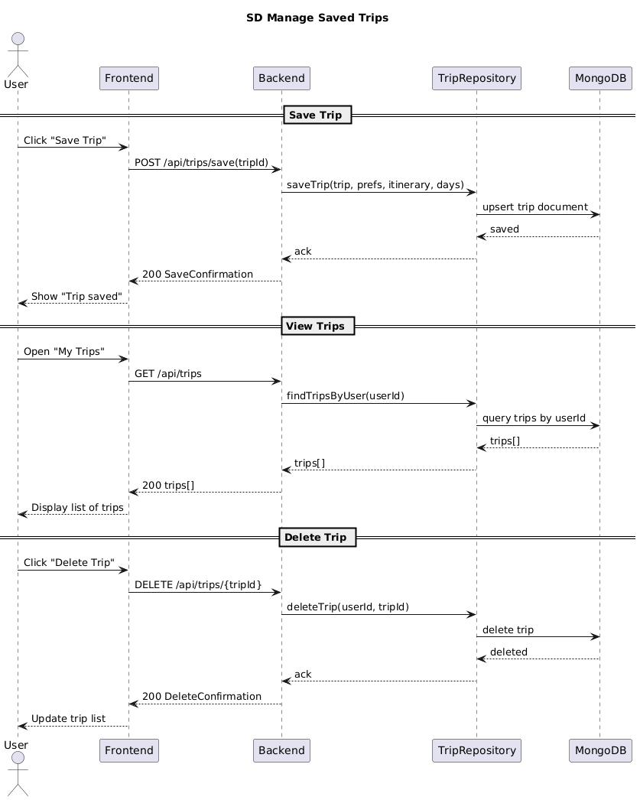
SD4 Managed saved Trips

Slide 15
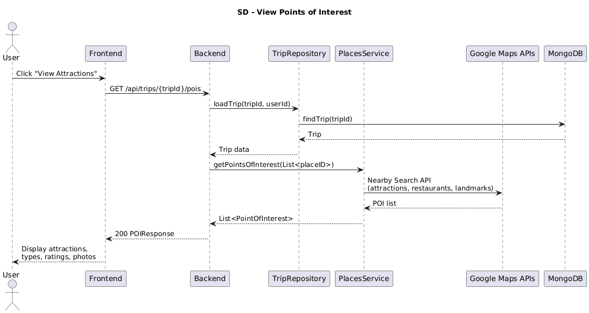
SD5 viewpoints of interest

Slide 16
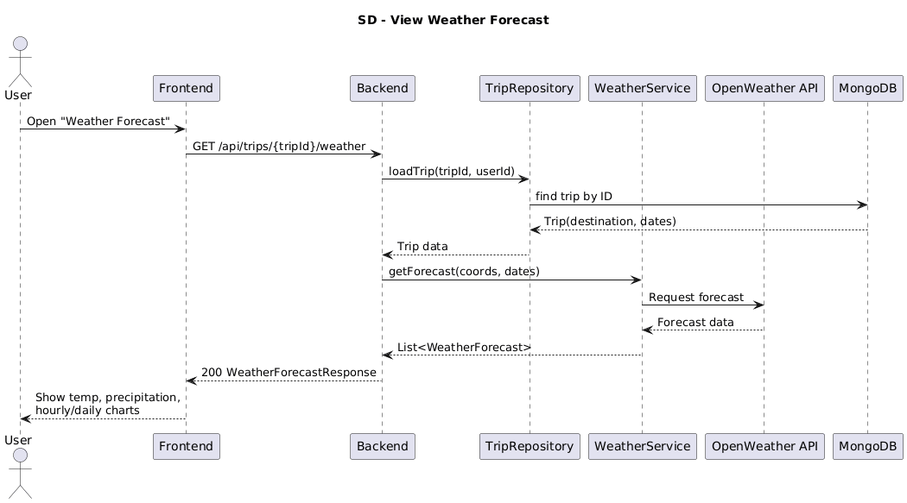
SD6 view weather forecasts

Slide 17
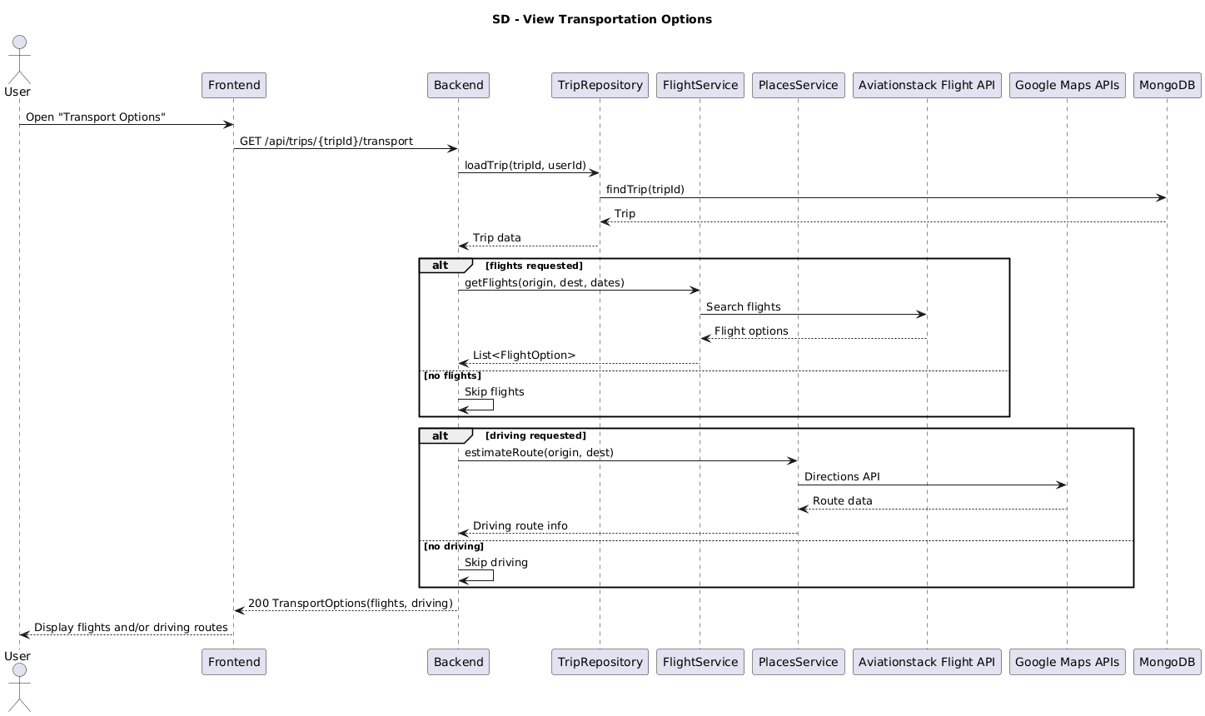
SD7 View Transportation

Slide 18
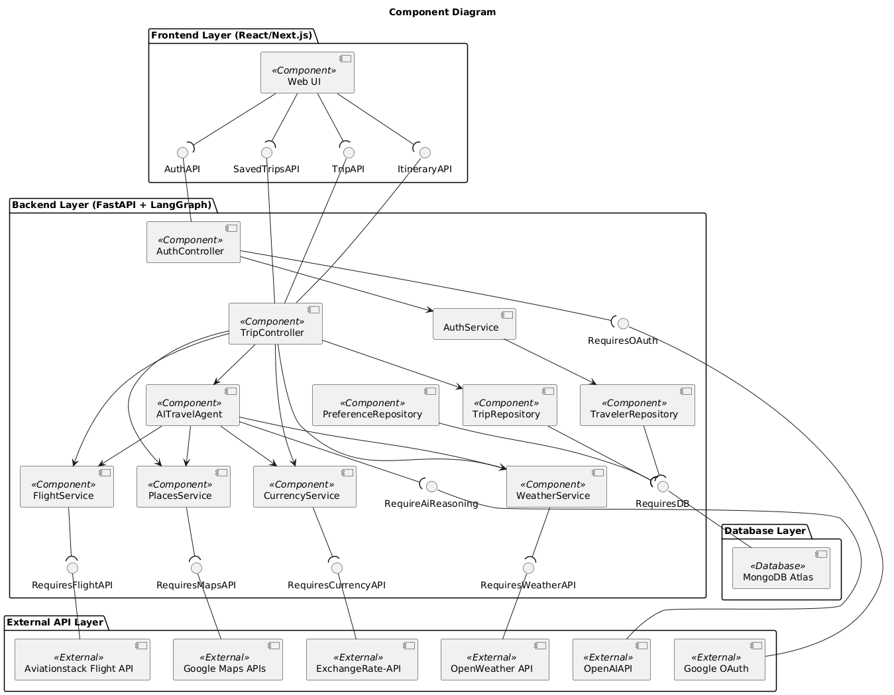
Component Diagram

Slide 19
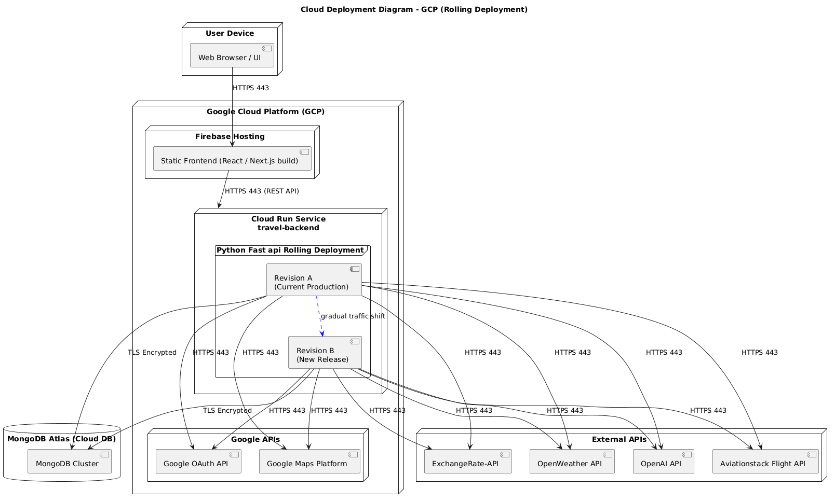
Deployment Diagram

Slide 20
Design pattern Influences
GRASP
Controller: The backend uses controllers like TripController and AuthController to handle operations (e.g., planTrip, generateItinerary, login) and coordinate with the UI.
Low coupling/ high cohesion: Each service (WeatherService, FlightService, PlanService, Currency Service) is responsible for a single external API, reducing coupling and keeping responsibilities focused.
Pure fabrication and indirection:
OpenAIService is a pure fabrication, hiding OpenAI details from the AI travel agent.
TripRepository and PreferenceRepository act as an indirection layer to MongoDB Atlas.
SOLID
Single Responsibility Principle: AITravelAgent is responsible for AI reasoning using Lang Graph/OpenAI, while controllers handle HTTP, and services handle external data retrieval
Dependency Inversion Principle: Controllers depend on services and repositories instead of concrete implementations, making it easier to test and swap APIs.

Slide 21
Demo Time

